Slide 1
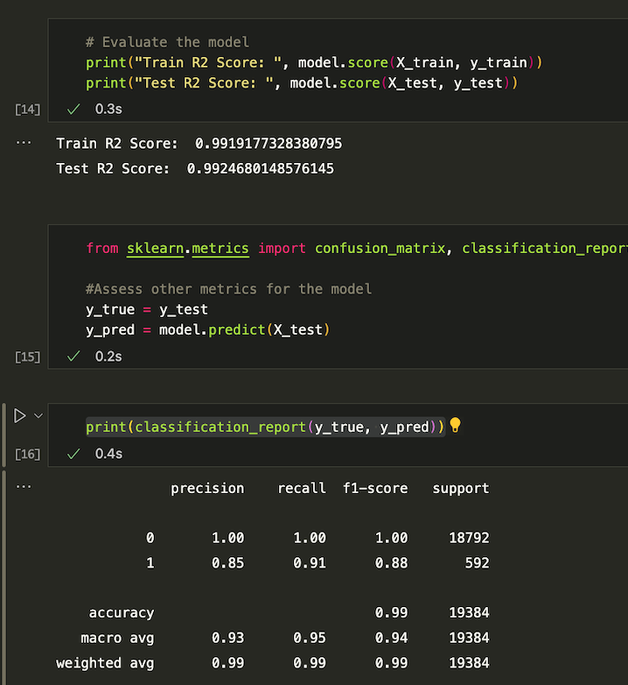
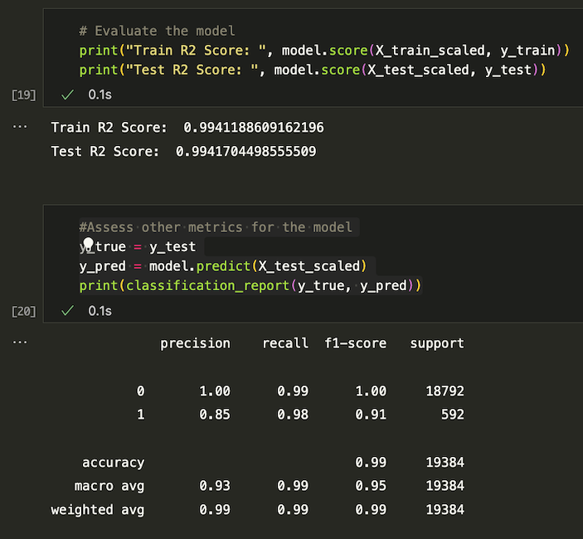
Linear Regression– no preprocessing
Linear Regression – Preprocessed

Slide 2
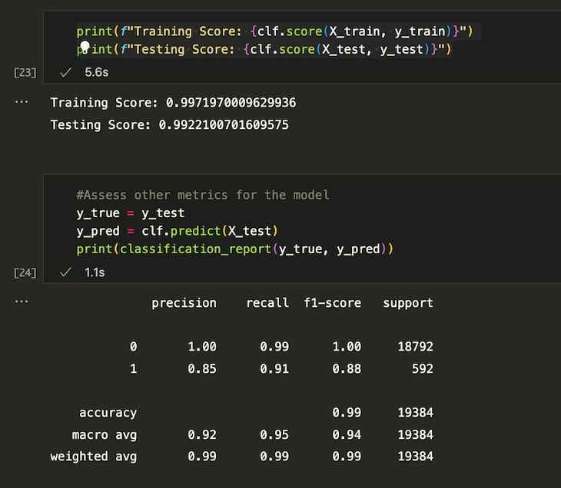
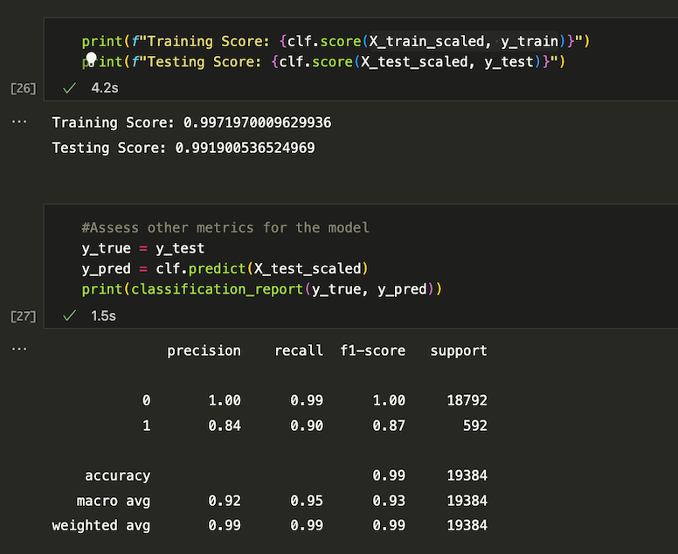
Random Forest Classifier – no preprocessing
Random Forest Classifier – Preprocessed

Slide 3
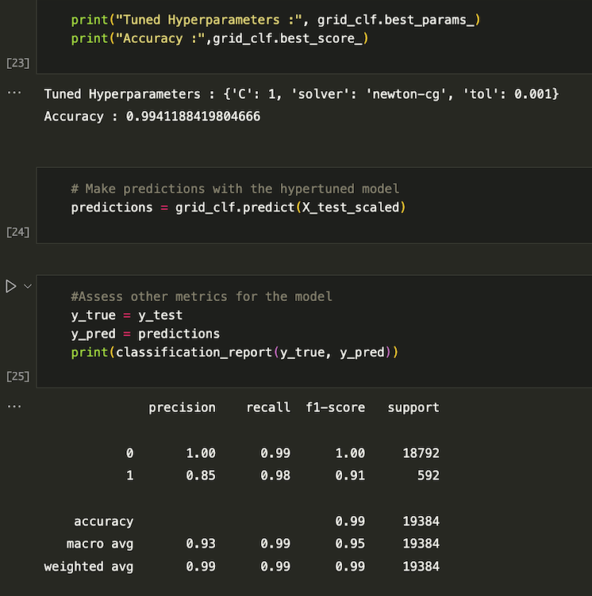
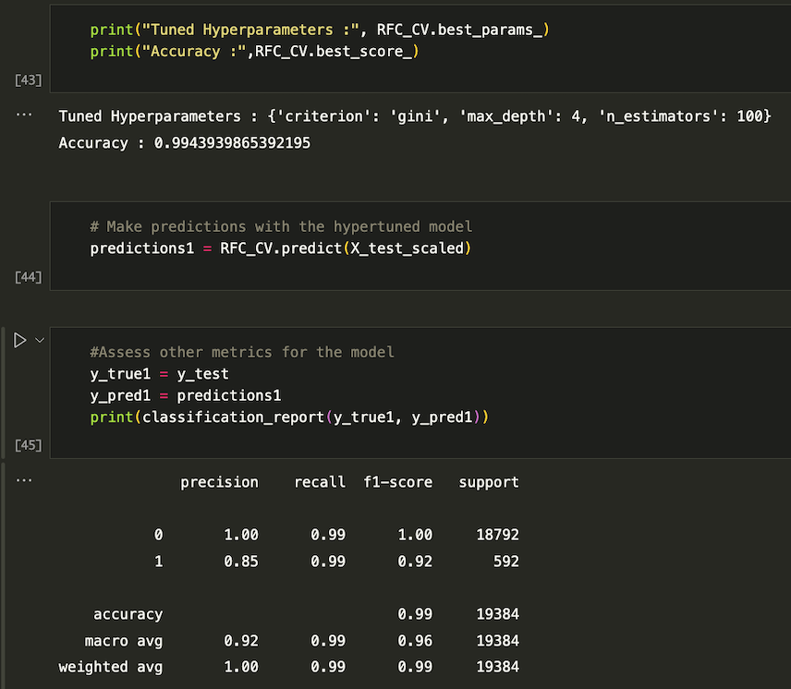
Hyperparameter Tuning - Linear regression
Hyperparameter Tuning – Random Forest Classifier

